Slide 2
Transforming Readiness: Preparing the NRC for the Next Era of Power Uprates
Mike Mahoney
Acting Chief
Division of Operating Reactor Licensing
Office of Nuclear Reactor Regulation

Slide 3
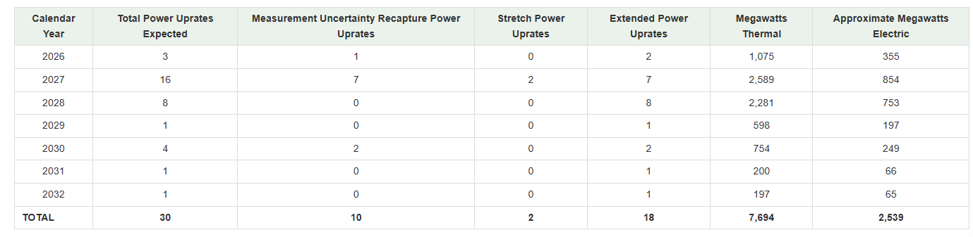
Power Uprate Forecast (by unit)
*Responses to Regulatory Issue Summary 2025-02, "Planned Power Uprate-Related Licensing Submittals for All Power Reactor Licensees
https://www.nrc.gov/reactors/operating/licensing/power-uprates/status-power-apps/expected-applications

Slide 4
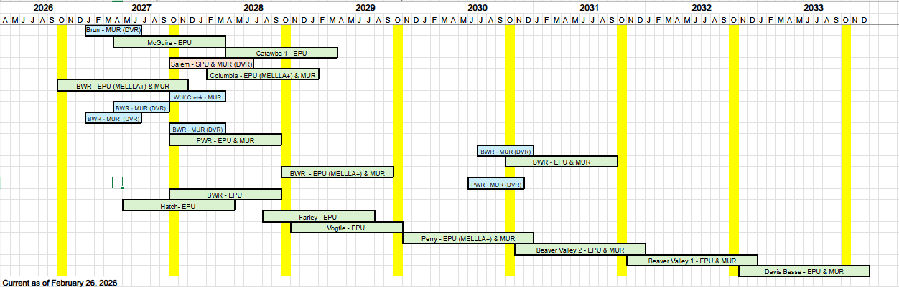
Power Uprate Forecast

Slide 5
Working Group Accomplishments
Regulatory Issue Summary
ACRS Coordination
Delegation Memo
Update of public site with previous uprates
Draft Graded Approach Guidance Issued
Continued Public Engagements (next meeting on March 19, 2026)

Slide 6
Activities in Progress
Safety Evaluation Templates
NRC Dashboards for Planned Power Uprates
Refining the Power Uprate Graded Approach
Use of Ai for Power Uprate Reviews

Slide 7
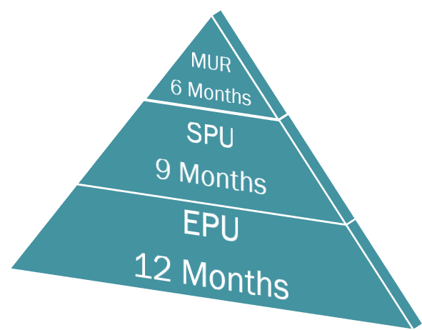
Power Uprate Review Timelines
Aligns with May 7, 2024, letter from NRC to
Nuclear Energy Institute (ML24106A068)
*After acceptance review complete

Slide 8

Use of Ai for Power Uprate Reviews
Project Management Technical Reviewer
Comparing application with precedents
Checking application against past RAIs
Technical evaluation templates
Extraction of relevant licensing basis info
Project Manager Companion
Acceptance Review
(PM scope)
Acceptance Memo
Graded Approach Screening
Kickoff meeting information
Plant Summary

Slide 9
Next Steps
Continued Stakeholder Engagement (March 19 public meeting)
Focused use of pre-application meetings
  Focus on resource intensive technical areas:
    Steam Dryer/Adverse Flow Effects
    Containment Accident Pressure
    Transient and Accident Analyses
  Graded approach/Binning
https://www.nrc.gov/reactors/operating/licensing/power-uprates

